Slide 1
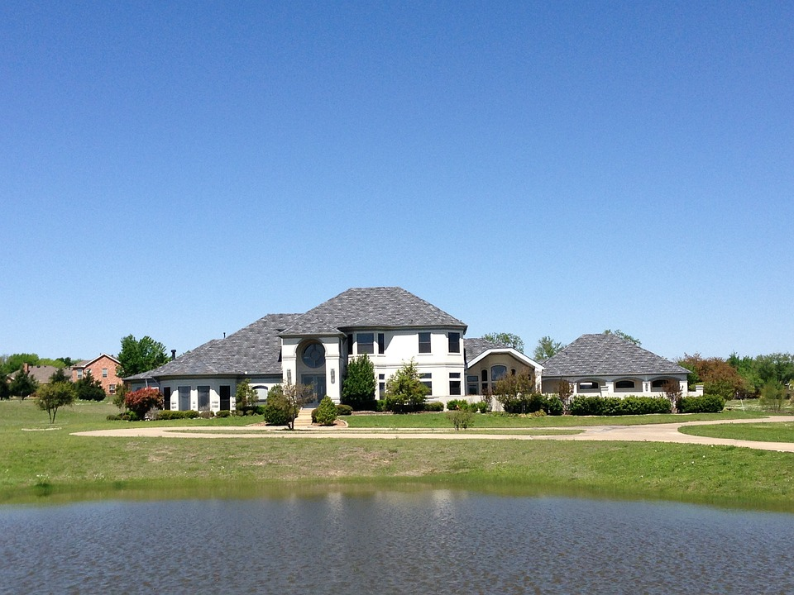
Project Phase 2
An analysis and modeling of King's County Home Sales dataset
By G-One Limited

Slide 2
G-One Limited members
Nazrah Nyangwara
Loise Hellen
Bahati Ndwiga
Felix Awino
Robin Mutai
Stephen Ndirangu
Daniel Ndirangu

Slide 3
Business understanding
G-One Limited is a real estate agency that helps homeowners buy and/or sell homes. Our client, a family of three has approached us to help them settle on a home that will have the highest resell value.
Our intention is to help the family get insight into the features that will most contribute to the highest or best sales of the housing units.
To achieve this, we will analyze the King's County home sales dataset.

Slide 4
Data Understanding
The dataset was obtained from Kings County housing dataset contained in a CSV file named kc_house_data.csv.
The file contains information on over 21,000 housing units. The data is organized into a table with several columns containing different information about the houses.
We noted that the data was collected between the time period of 2014 and 2015
Some of the challenges encountered during data preparation included the presence of missing values, outliers and placeholders.
We went through data preparation and modeling to come up with our final conclusions for this project

Slide 5
Methods used
Data cleaning
We filled in missing values, and created some additional columns as necessary
Dropping some columns that we deemed not too relevant to the modeling.
Data Modeling:
We created a base model and subsequently added additional variables to come up with our final model
Our conclusions and recommendations were based on the final model

Slide 6
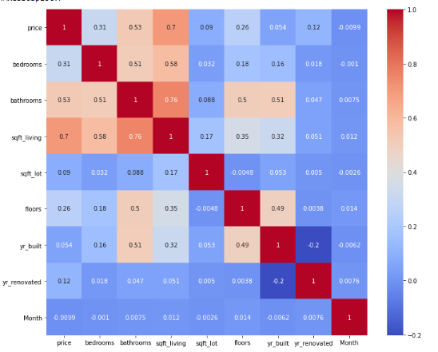
Correlation Heat map: Price vs Features

Slide 7
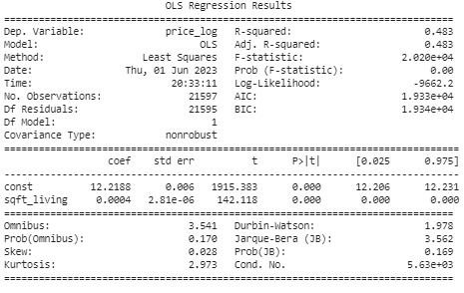
Baseline Model

Slide 8
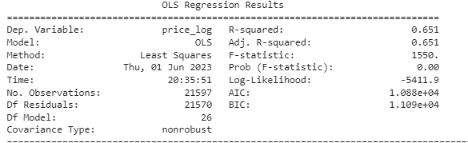
Final Model R-Squared

Slide 9
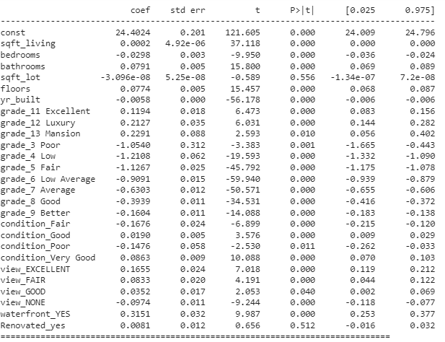
Final Model coefficients

Slide 10
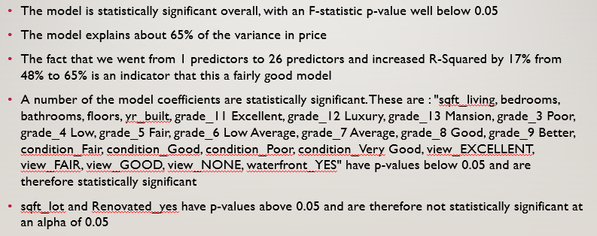
Findings
The model is statistically significant overall, with an F-statistic p-value well below 0.05
The model explains about 65% of the variance in price
The fact that we went from 1 predictors to 26 predictors and increased R-Squared by 17% from 48% to 65% is an indicator that this a fairly good model
A number of the model coefficients are statistically significant. These are : "sqft_living, bedrooms, bathrooms, floors, yr_built, grade_11 Excellent, grade_12 Luxury, grade_13 Mansion, grade_3 Poor, grade_4 Low, grade_5 Fair, grade_6 Low Average, grade_7 Average, grade_8 Good, grade_9 Better, condition_Fair, condition_Good, condition_Poor, condition_Very Good, view_EXCELLENT, view_FAIR, view_GOOD, view_NONE, waterfront_YES" have p-values below 0.05 and are therefore statistically significant
sqft_lot and Renovated_yes have p-values above 0.05 and are therefore not statistically significant at an alpha of 0.05

Slide 11
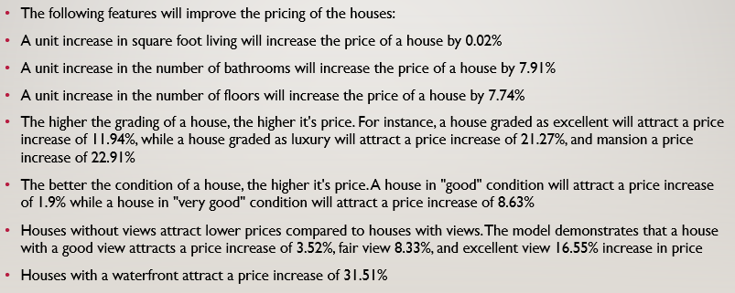
Interpretation of the coefficients
The following features will improve the pricing of the houses:
A unit increase in square foot living will increase the price of a house by 0.02%
A unit increase in the number of bathrooms will increase the price of a house by 7.91%
A unit increase in the number of floors will increase the price of a house by 7.74%
The higher the grading of a house, the higher it's price. For instance, a house graded as excellent will attract a price increase of 11.94%, while a house graded as luxury will attract a price increase of 21.27%, and mansion a price increase of 22.91%
The better the condition of a house, the higher it's price. A house in "good" condition will attract a price increase of 1.9% while a house in "very good" condition will attract a price increase of 8.63%
Houses without views attract lower prices compared to houses with views. The model demonstrates that a house with a good view attracts a price increase of 3.52%, fair view 8.33%, and excellent view 16.55% increase in price
Houses with a waterfront attract a price increase of 31.51%

Slide 12
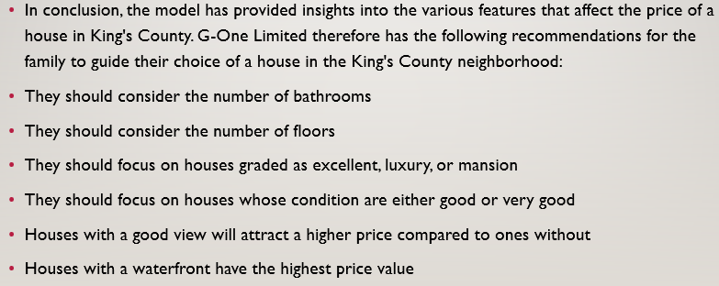
Conclusions and recommendations
In conclusion, the model has provided insights into the various features that affect the price of a house in King's County. G-One Limited therefore has the following recommendations for the family to guide their choice of a house in the King's County neighborhood:
They should consider the number of bathrooms
They should consider the number of floors
They should focus on houses graded as excellent, luxury, or mansion
They should focus on houses whose condition are either good or very good
Houses with a good view will attract a higher price compared to ones without
Houses with a waterfront have the highest price value

Slide 13
Thank you

